Slide 1


Slide 2




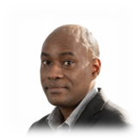
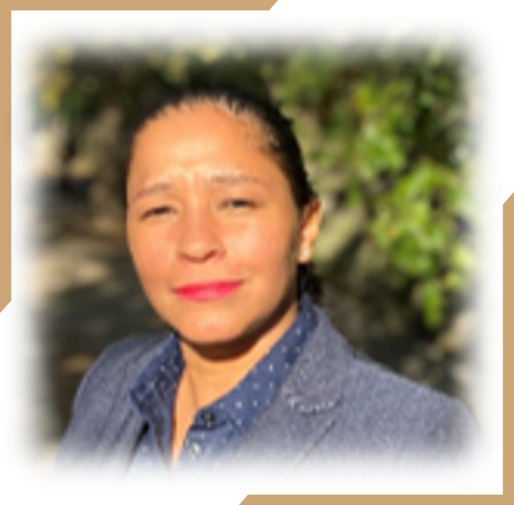
Our Team
Rey Rivera
Project Manager
Caleb Celius
Administrator
Antonio Rios
Chief Architect
Michael Major
Engineer
Kerri Smith
Engineer
Lora Lee Barreto
Engineer
CFO
Notes:
Rey - PM
Antonio – Chief architect
Caleb – Administrator web interface
Mike - Terraform
Lora - Terraform
Kerri - Documentation

Slide 3
Overview
Objectives
Goals
Solution
Pipeline
System Architecture
Infrastructure
Backlog
Questions

Slide 4
Our Objective
To demonstrate mastery of the CI/CD pipeline
To deploy an application to a production environment
To utilize and diagram infrastructure as code
To demonstrate effective project management
Production Team
Application Budget
Timeline
6 members
2.5 wks
$200 USD

Slide 5


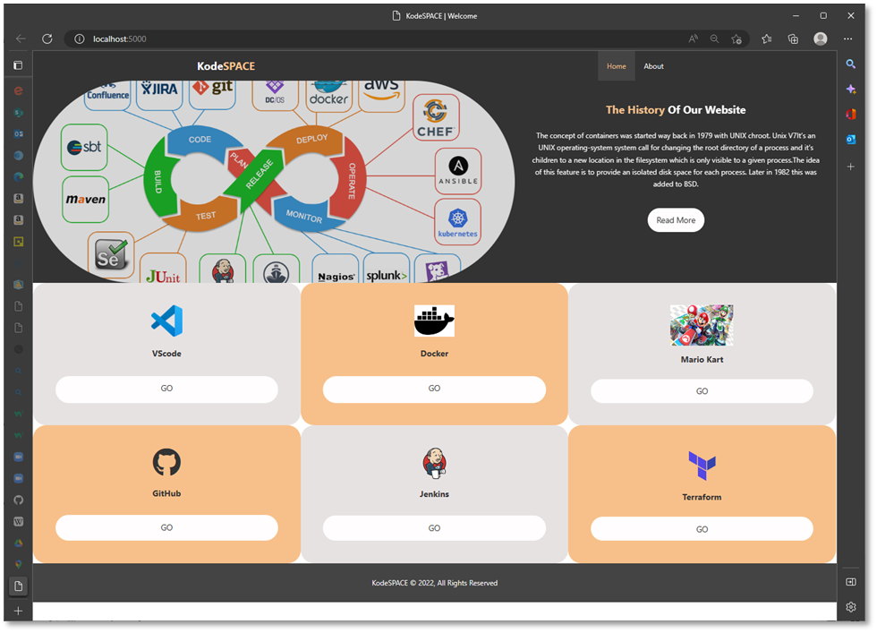
Our Goal
We aim to consolidate your development experience by offering an environment that contains pre-configured tools accessible on-demand from any browser.
KodeSPACE
Consolidated Workstation
Notes:
To build a service that hosts a platform of microservices that are combined to make a playground for fledgling developers.
The services are containerized and use ECS, Fargate to provide a serverless infrastructure and auto scale according to user traffic.
Our infrastructure includes Terraform as IaC (Infrastructure as Code) and Docker for configuration of containers.

Slide 6


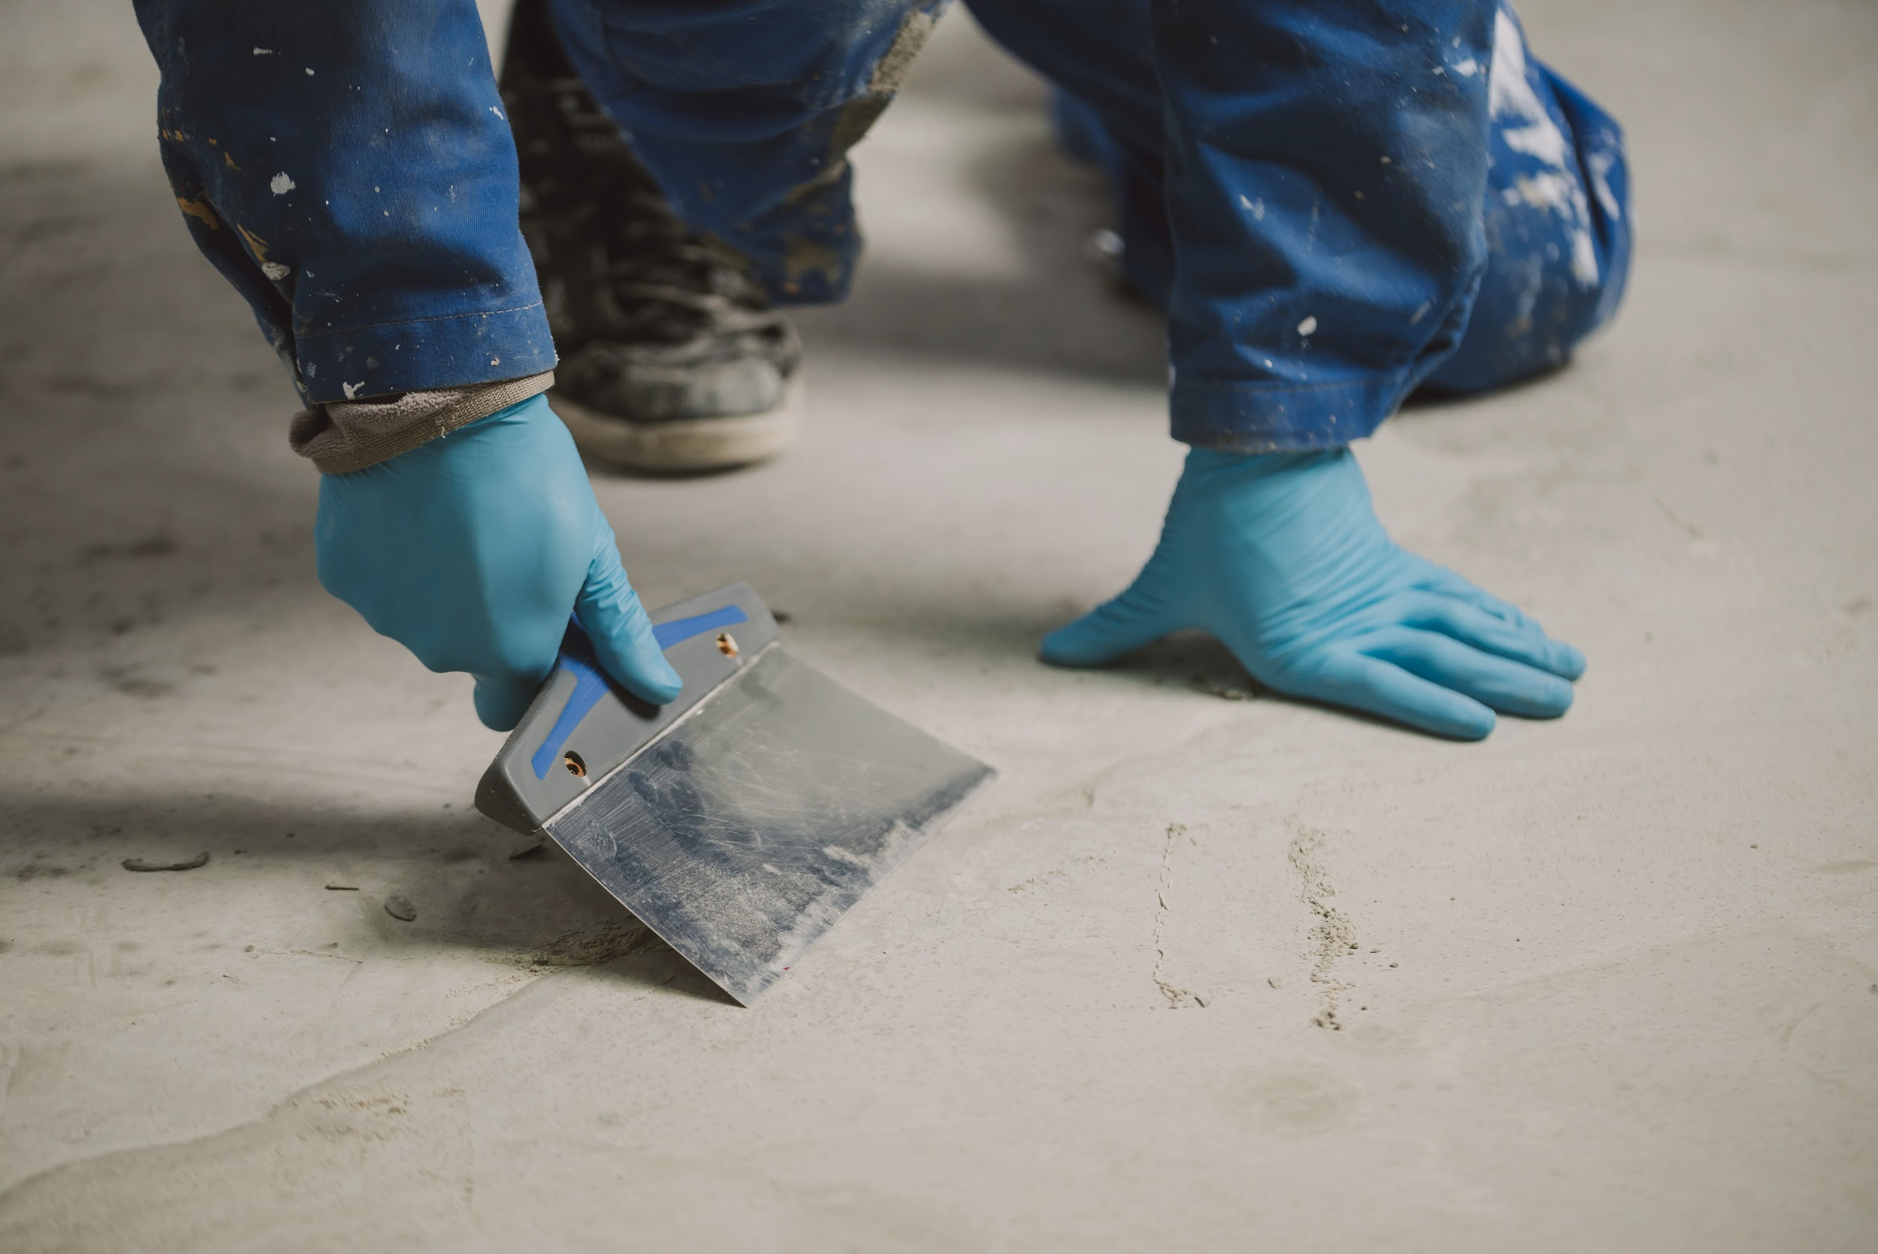
Our Audience
Training Academies
Fledgling developers
Independent Learners
01
03
Student toolkit
02
Learning journey starting point.

Slide 7
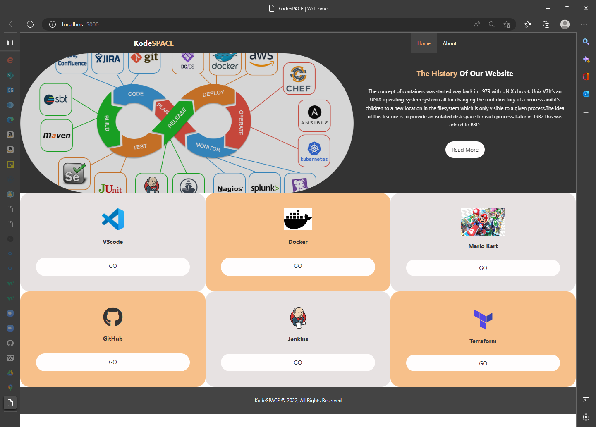
Application
Notes:
2 service redirects
4 applications
We will get chewed out if we market GitHub and VSCode as an application we provide

Slide 8
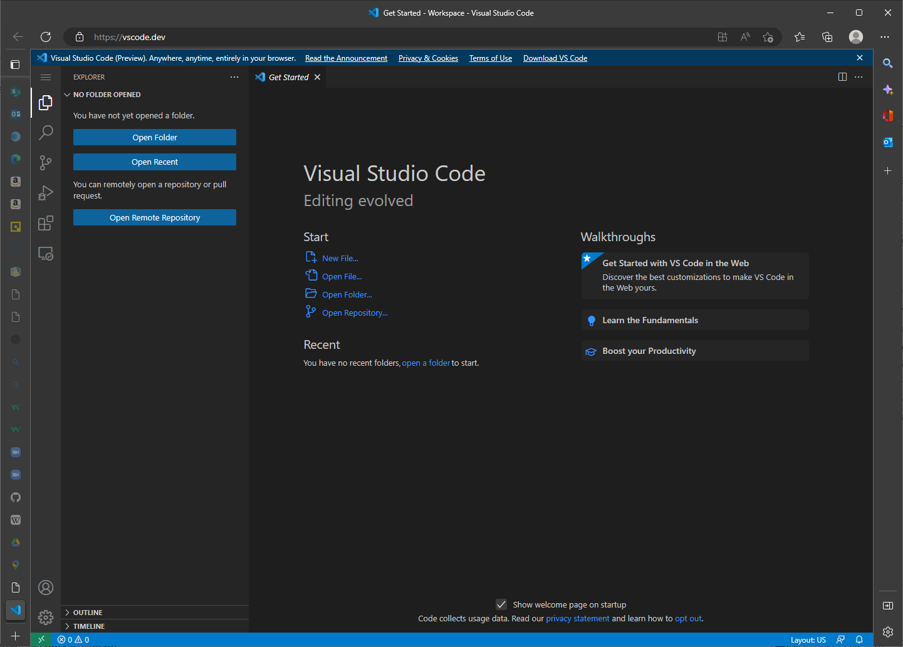
Application

Slide 9
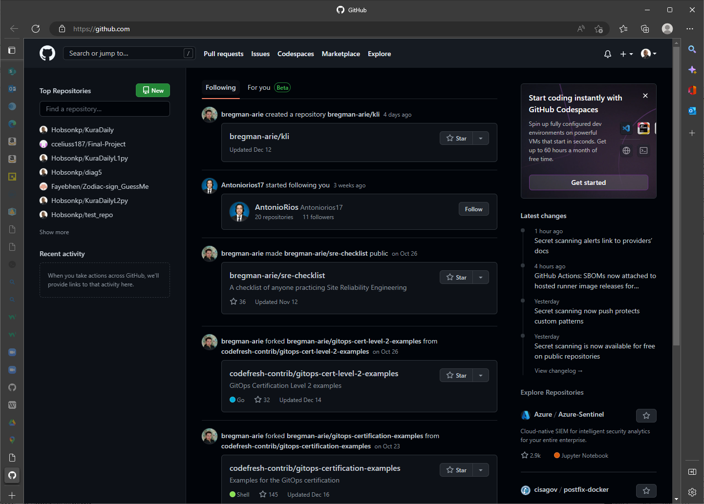
Application

Slide 10
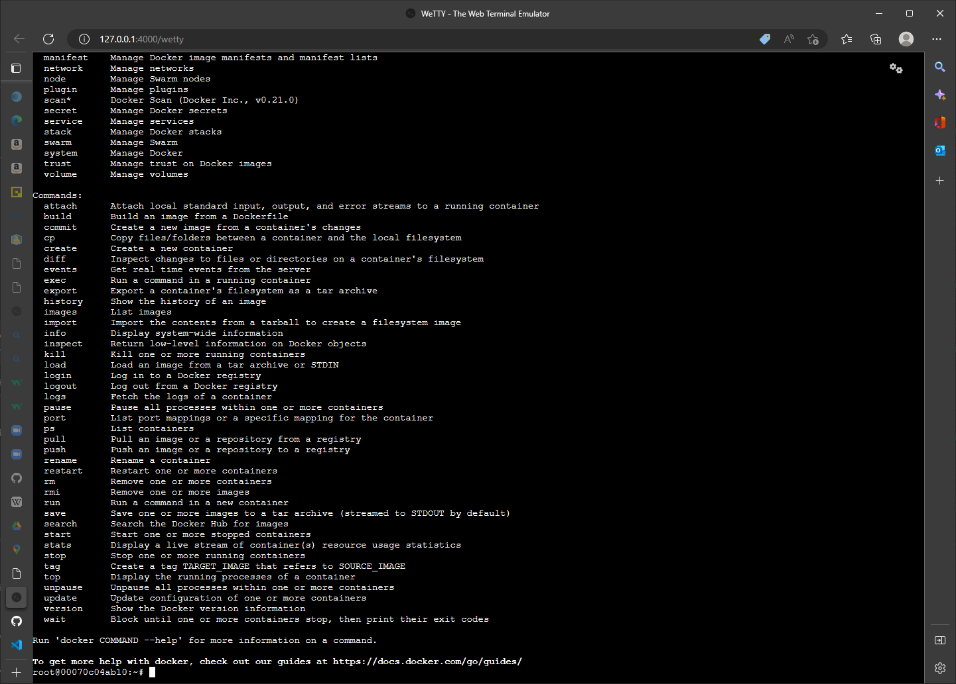
Application

Slide 11
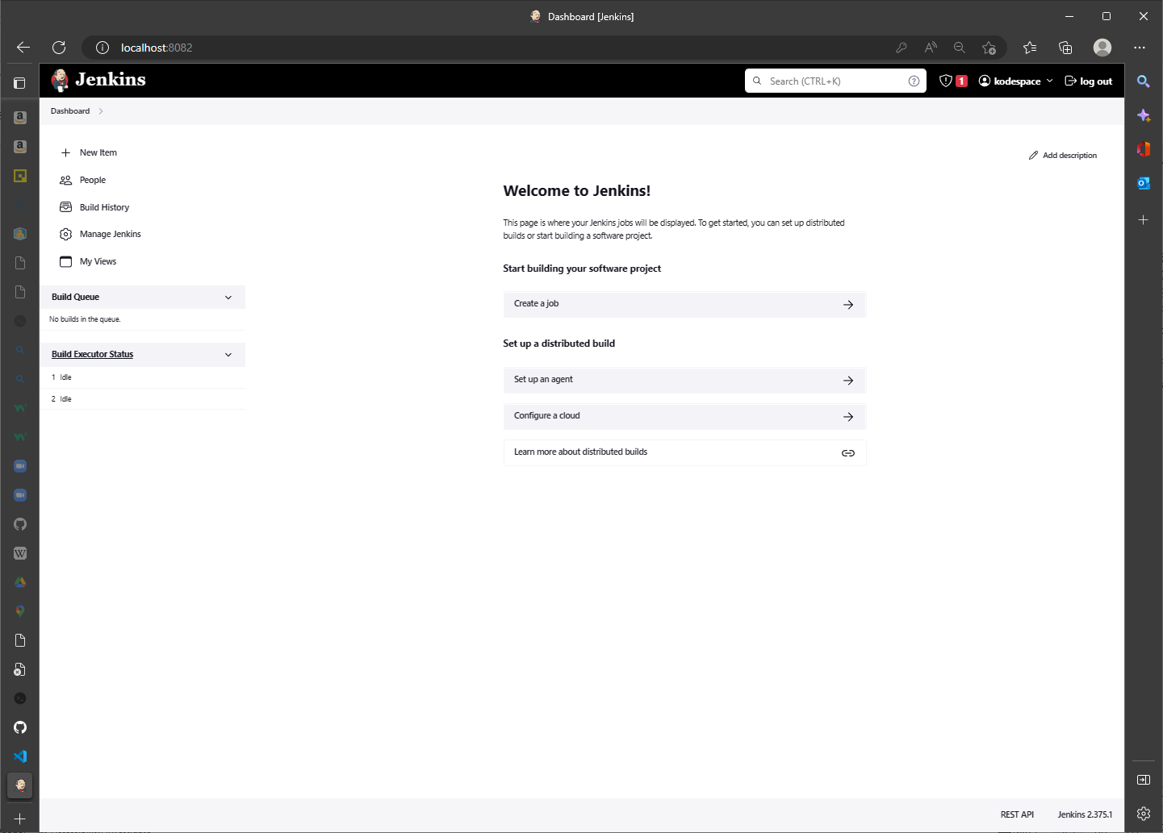
Application

Slide 12
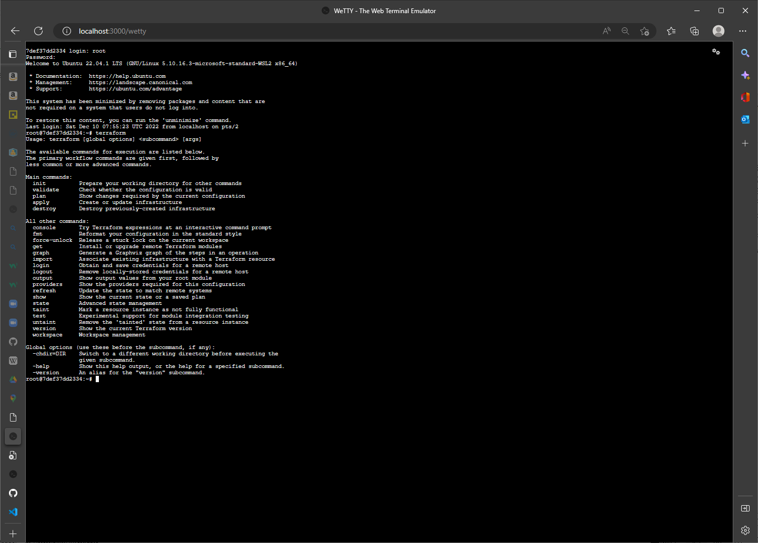
Application

Slide 13
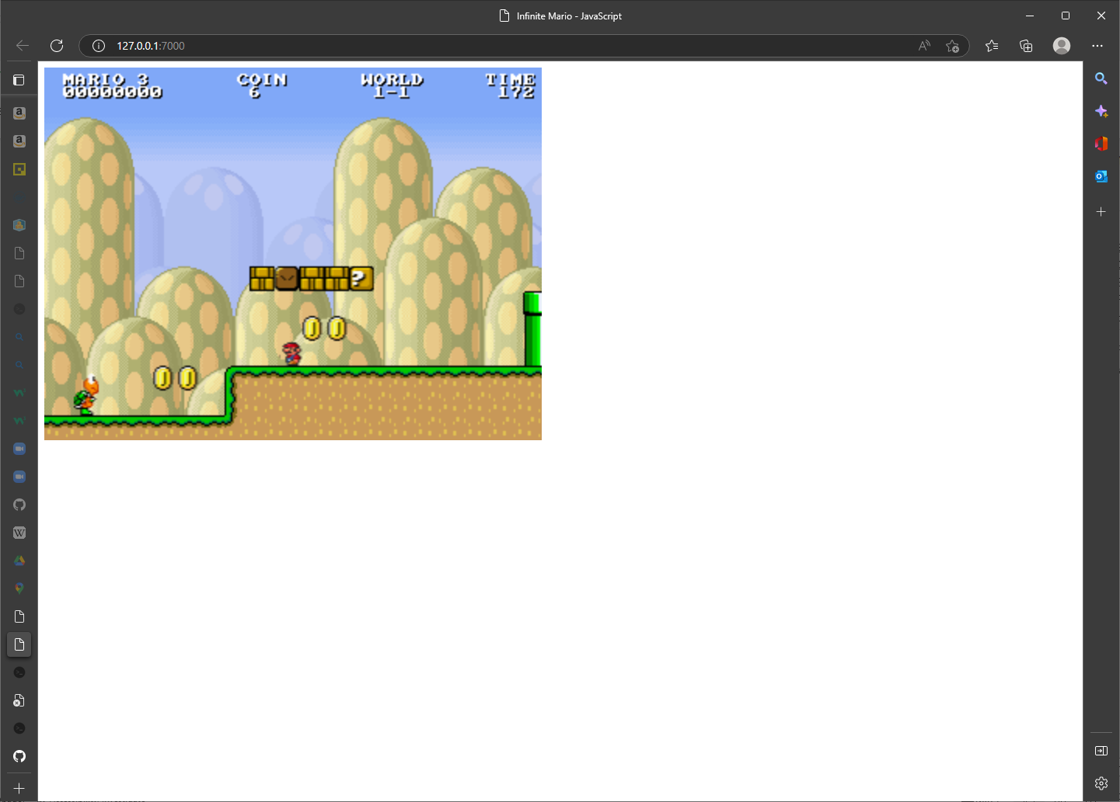
Application

Slide 14





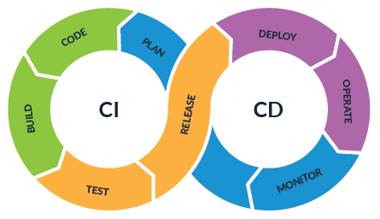







Our Process

Slide 15
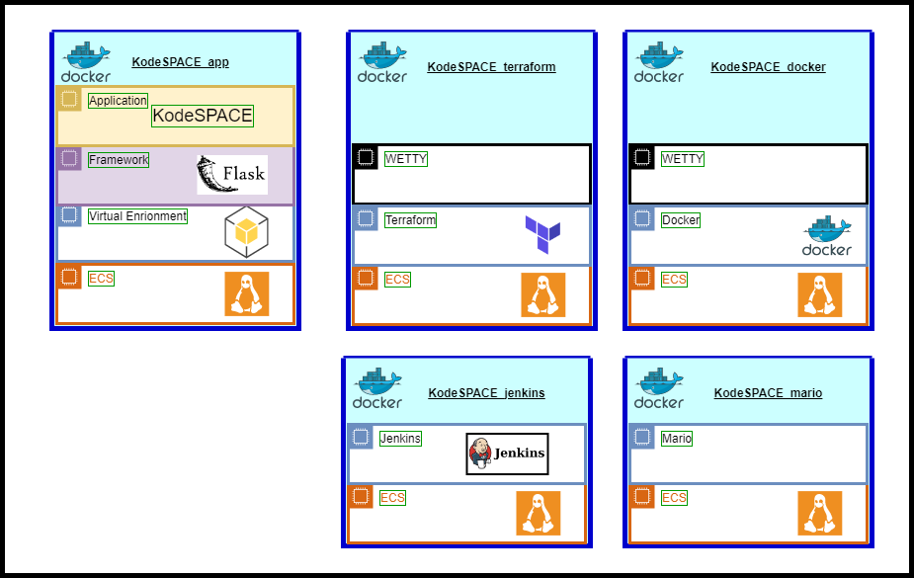
System Architecture - stack

Slide 16
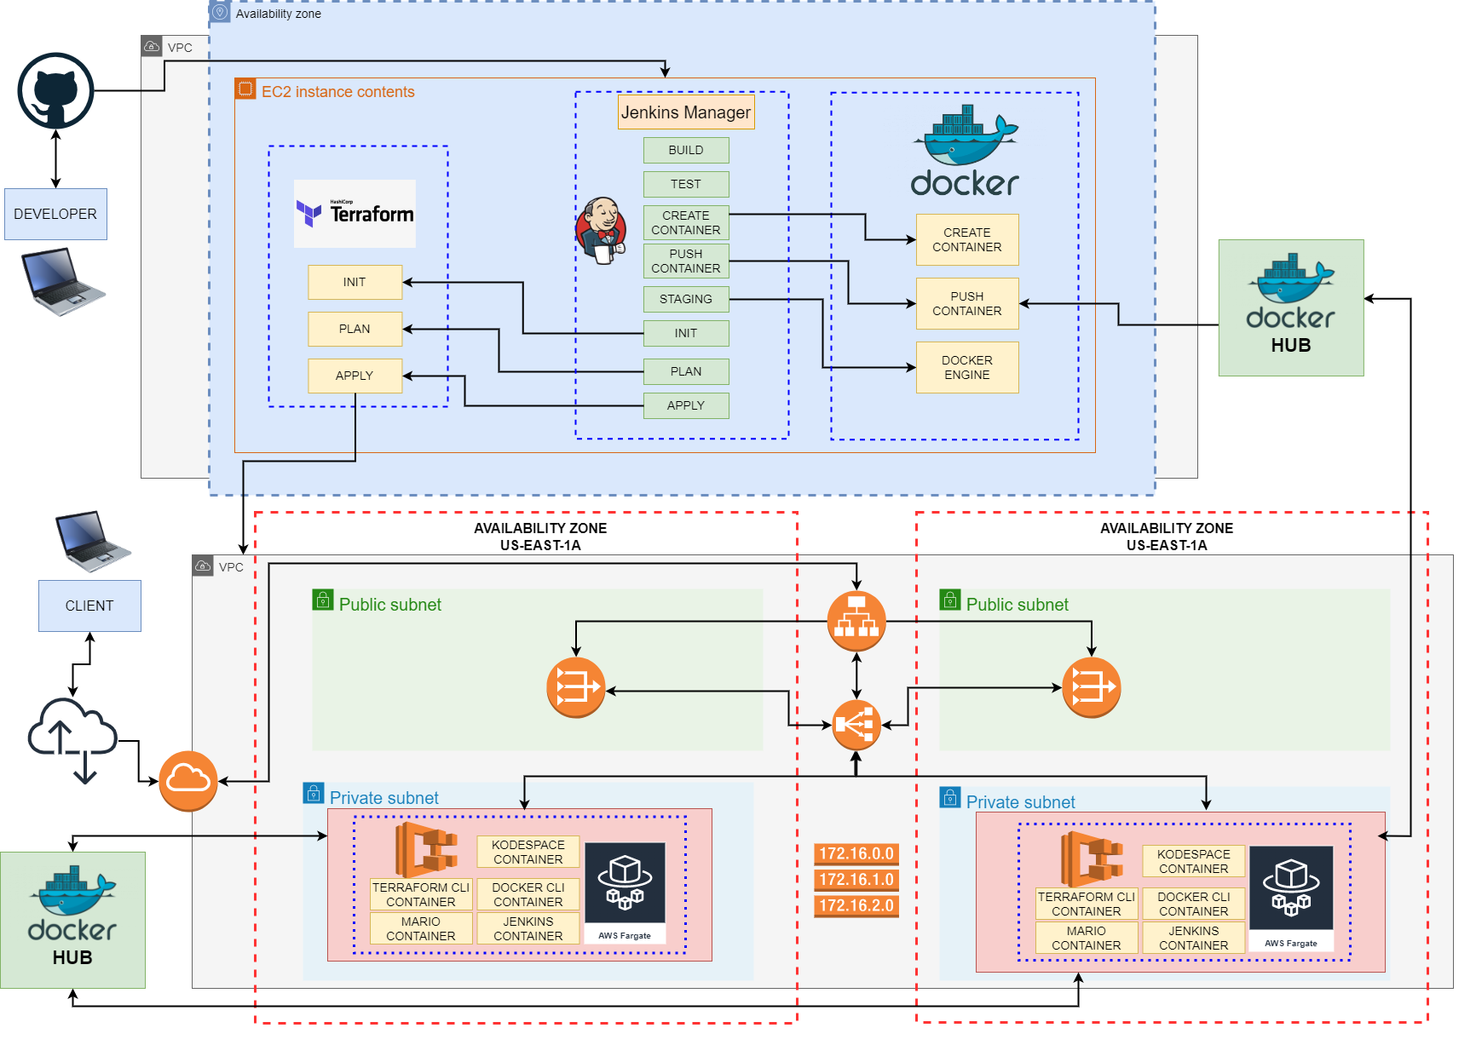
System Architecture

Slide 17
Future Vision
Make it work
User/content management system
Serverless with lambda
Persistent storage
Additional DevOps tools

Slide 18
Thank you.

Slide 19
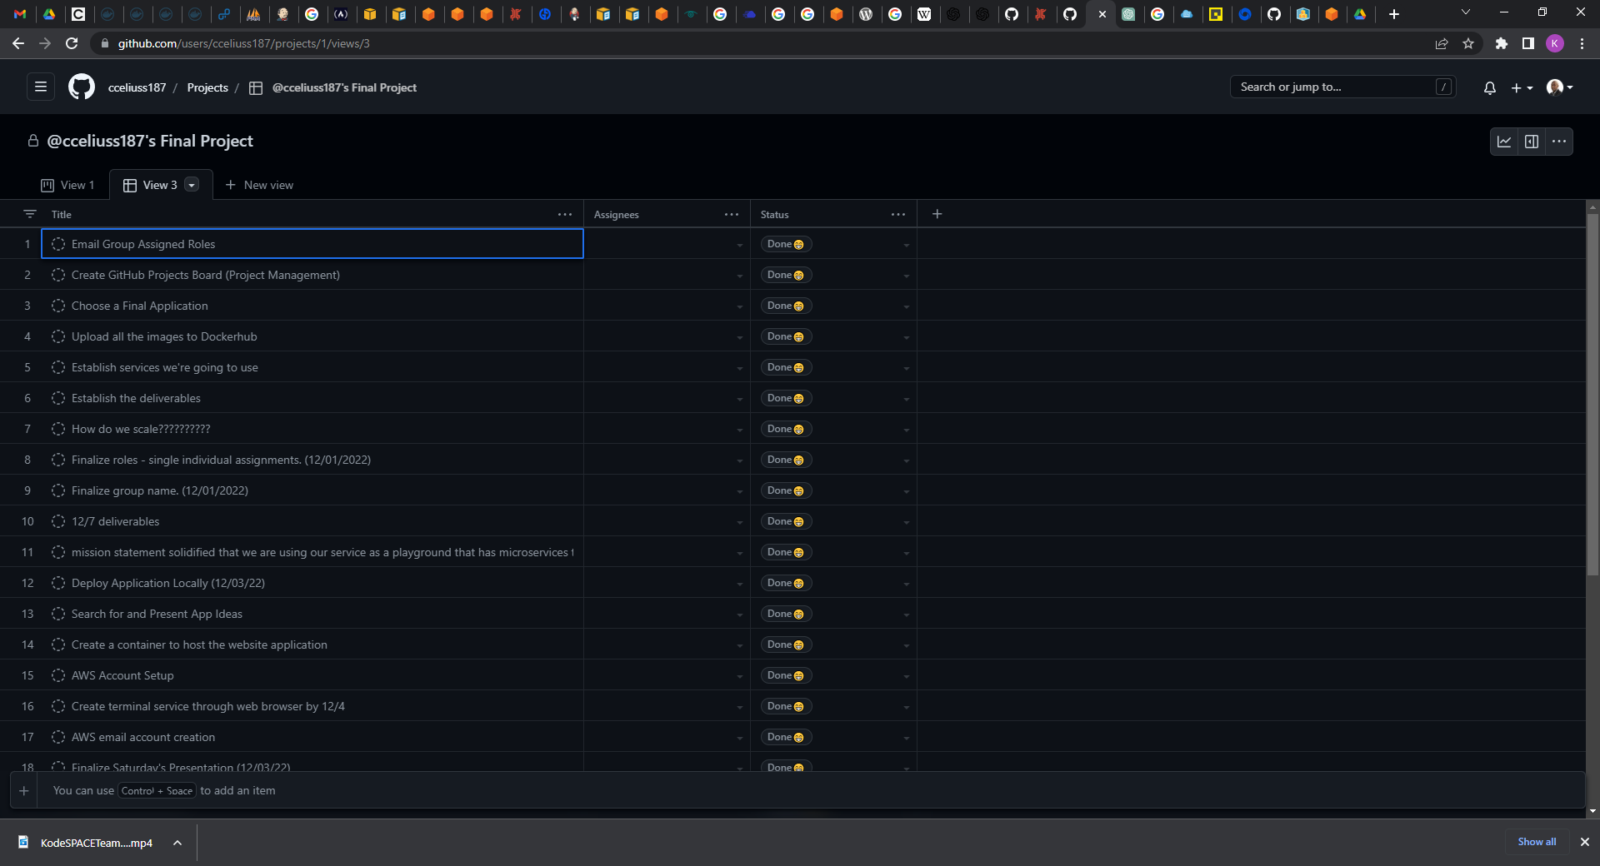
Github - Project

Slide 20
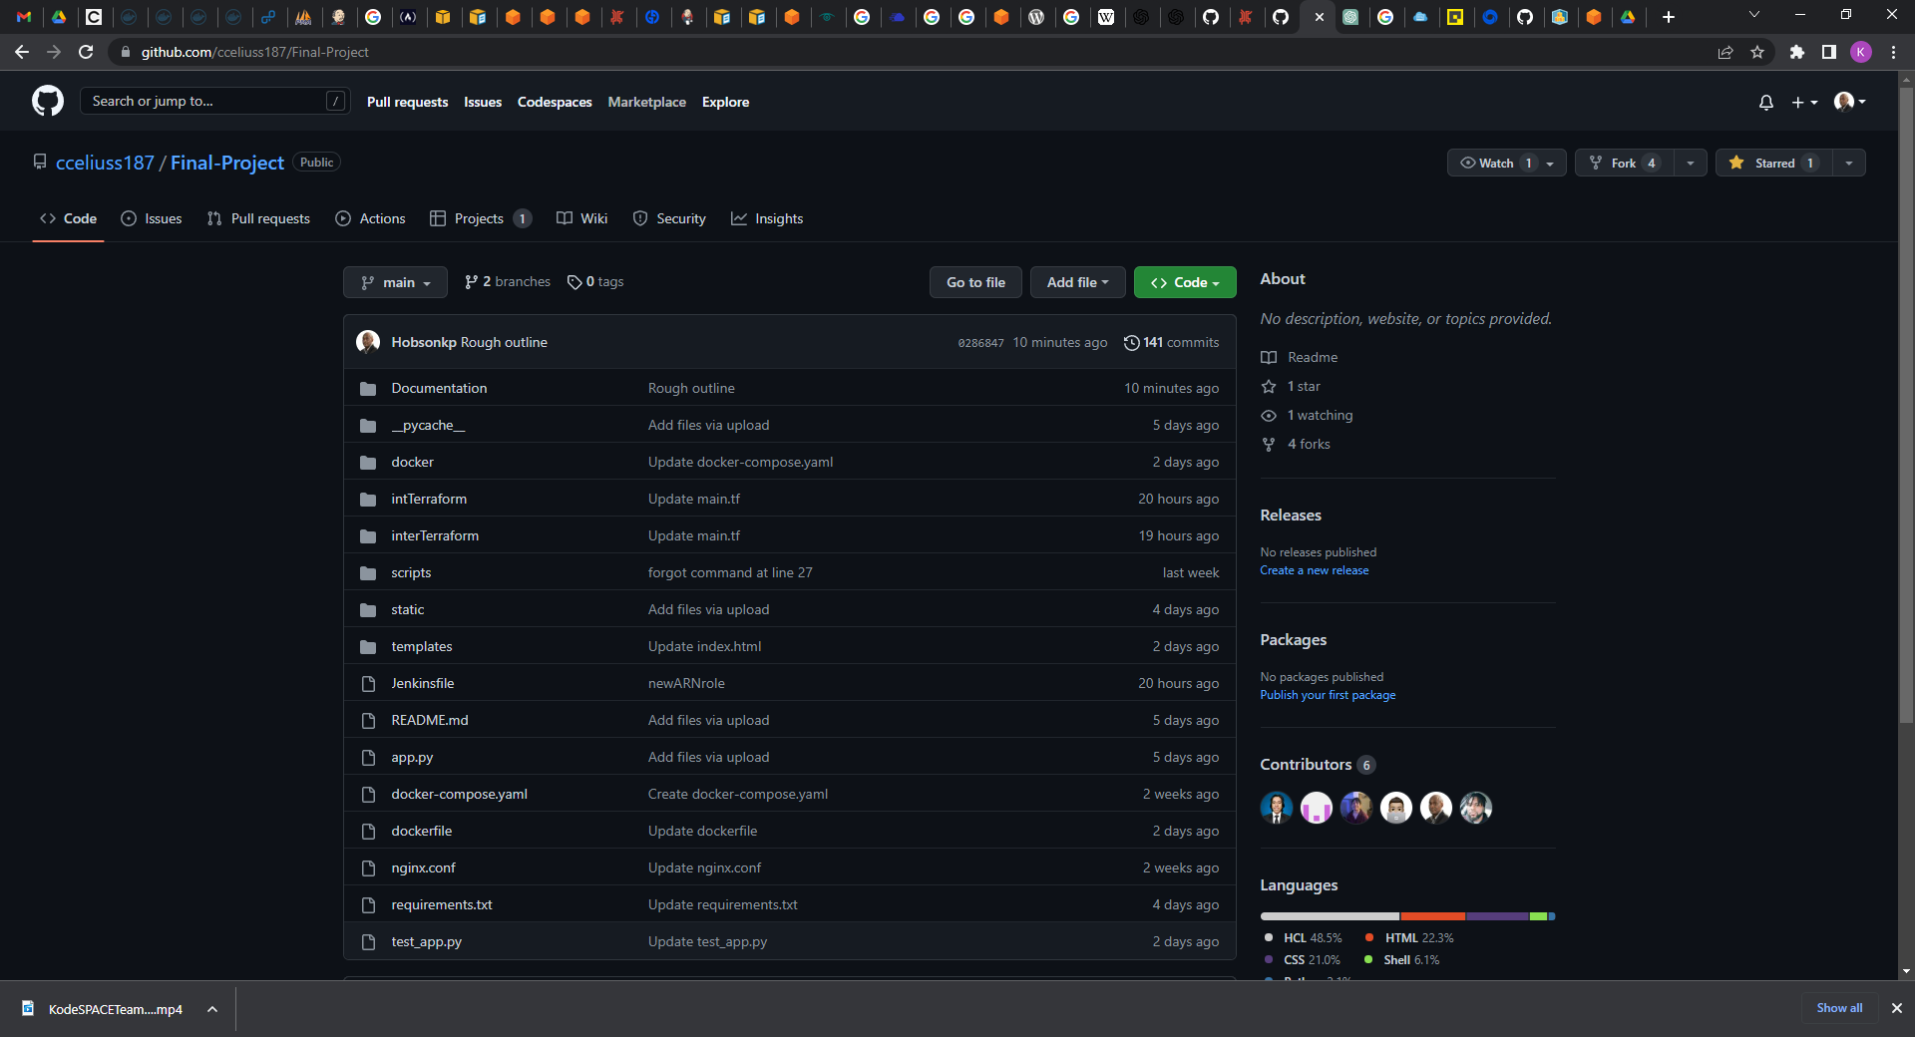
Github - Repository

Slide 21
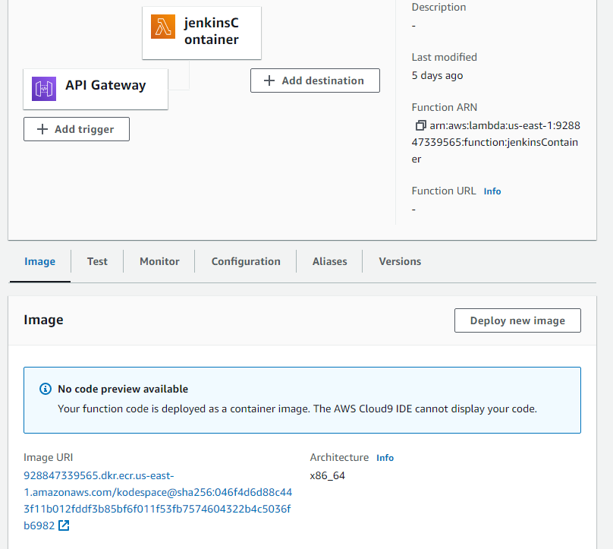
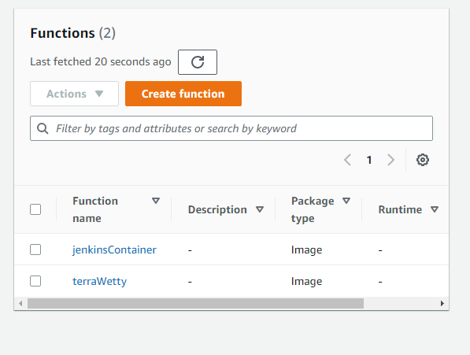
Lamda

Slide 22
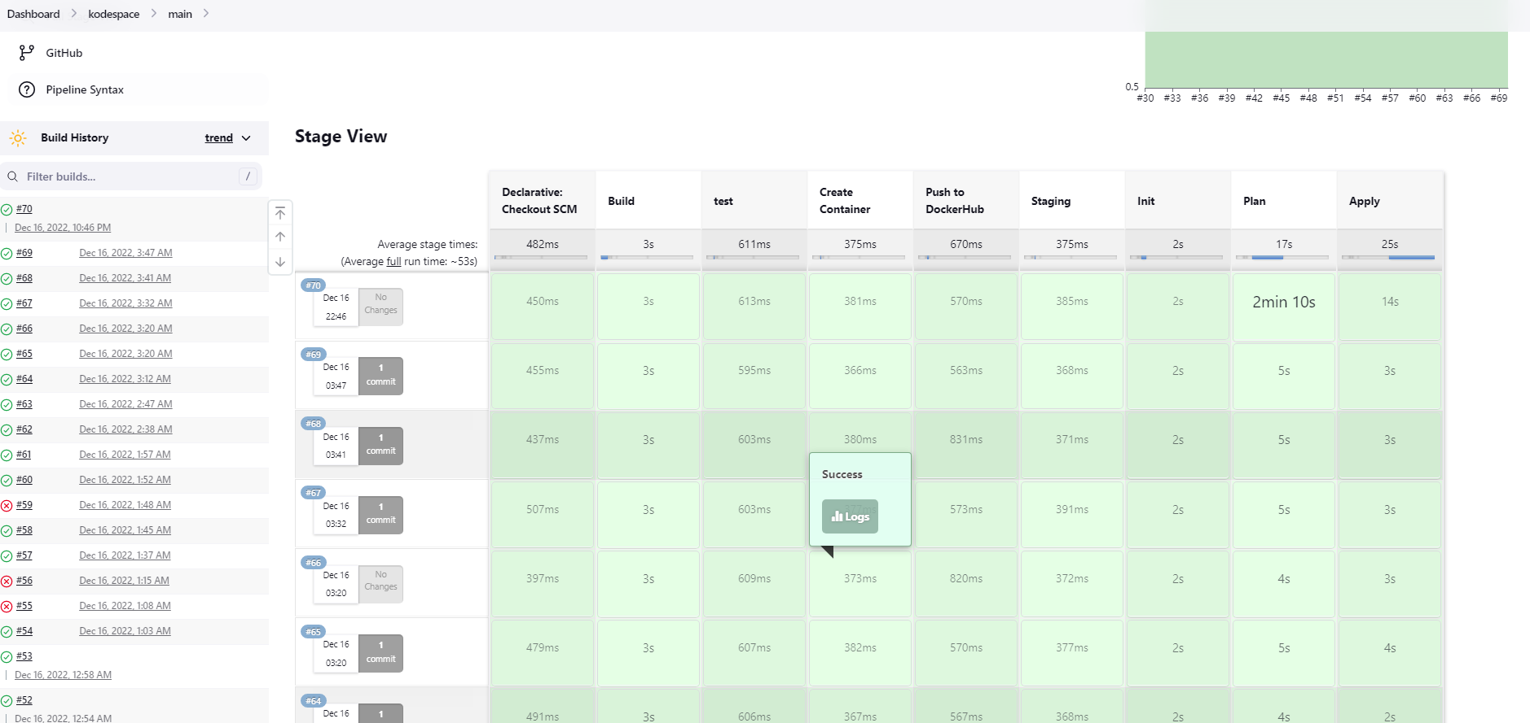
Jenkins

Slide 23
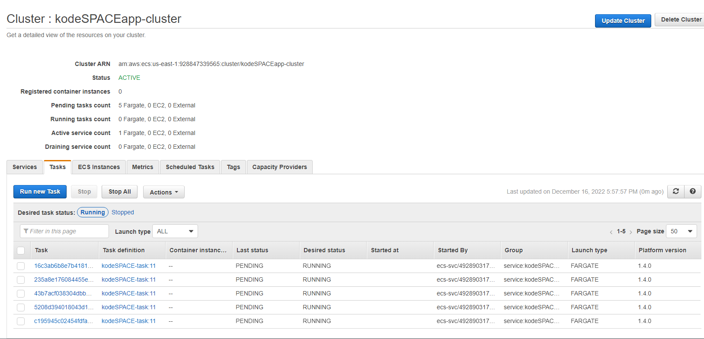
ECS

Slide 24

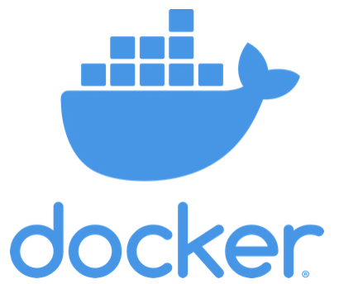




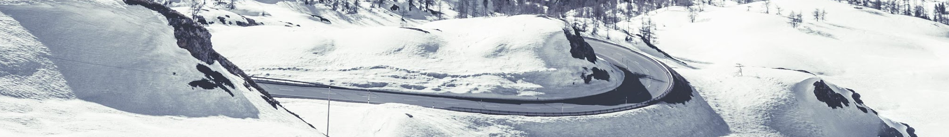
Menu of Solutions
1
VScode
3
Docker
5
Games
2
GitHub
4
Jenkins
6
Terraform

Slide 25
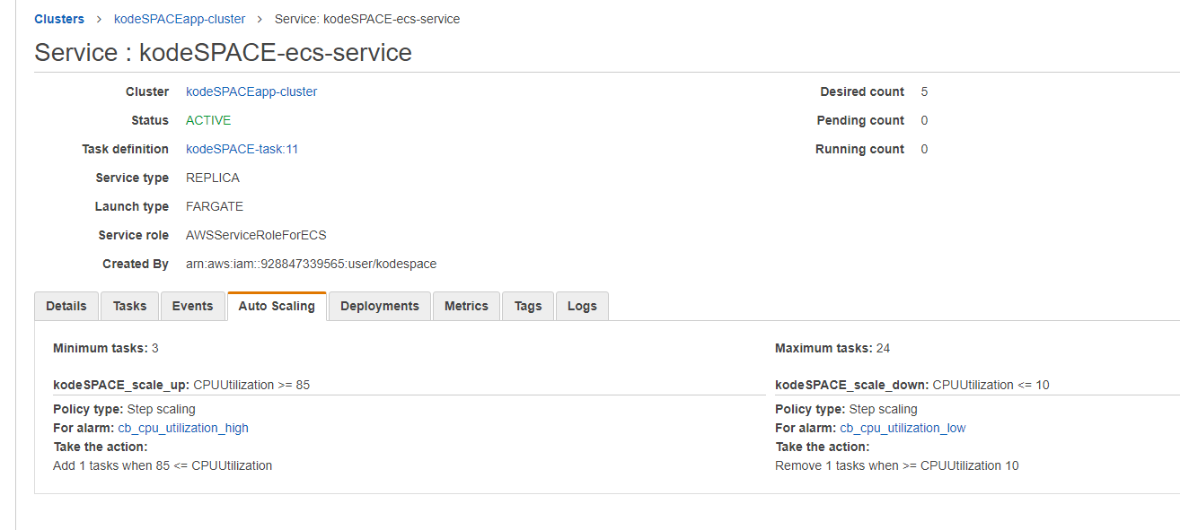
Autoscaling

Slide 26
Cloudwatch

Slide 27
Iac Docker

Slide 28
Dockerhub

Slide 29
Iac Terraform

